Slide 1
Week 5 Update
AA 290 / AA 279D
10/21/2019

Slide 2
Contents
Correction from last time:
Orbital element oscillation
Bounding the motion in inertial simulation
Also, able to circularize the orbit to move between waypoints
Created an HCW simulation
Looked at rectilinear vs. curvilinear frame
Added in computer that has logic for moving to waypoints

Slide 3
Oscillating Orbital Elements
I wasn’t looking at the orbital element plots close enough
Was unable to see the cyclic nature of the orbital element effects
Shortening the simulation time allows the cycles to be seen much more clearly

Slide 4
Inertial Simulation – Bounding Motion
The last steps before moving onto different simulation types (HCW, ROE, etc) was to show maneuvers in the inertial frame
Bounding the relative motion was the first maneuver
Burn Location

Slide 5
Inertial Simulation – Circularizing Orbit
After bounding the motion, I wanted to then show I could circularize the orbit to be able to move between near-circular orbits
Burn Location

Slide 6
Inertial → Other Representations
Calculating burn directions was a little difficult in the inertial frame
Used GVE to calculate dV to change semi-major axis and then used it again to change the eccentricity
Impulsive burns in Simulink can be difficult (see next slide) → easier to do in other representations I found out later

Slide 7
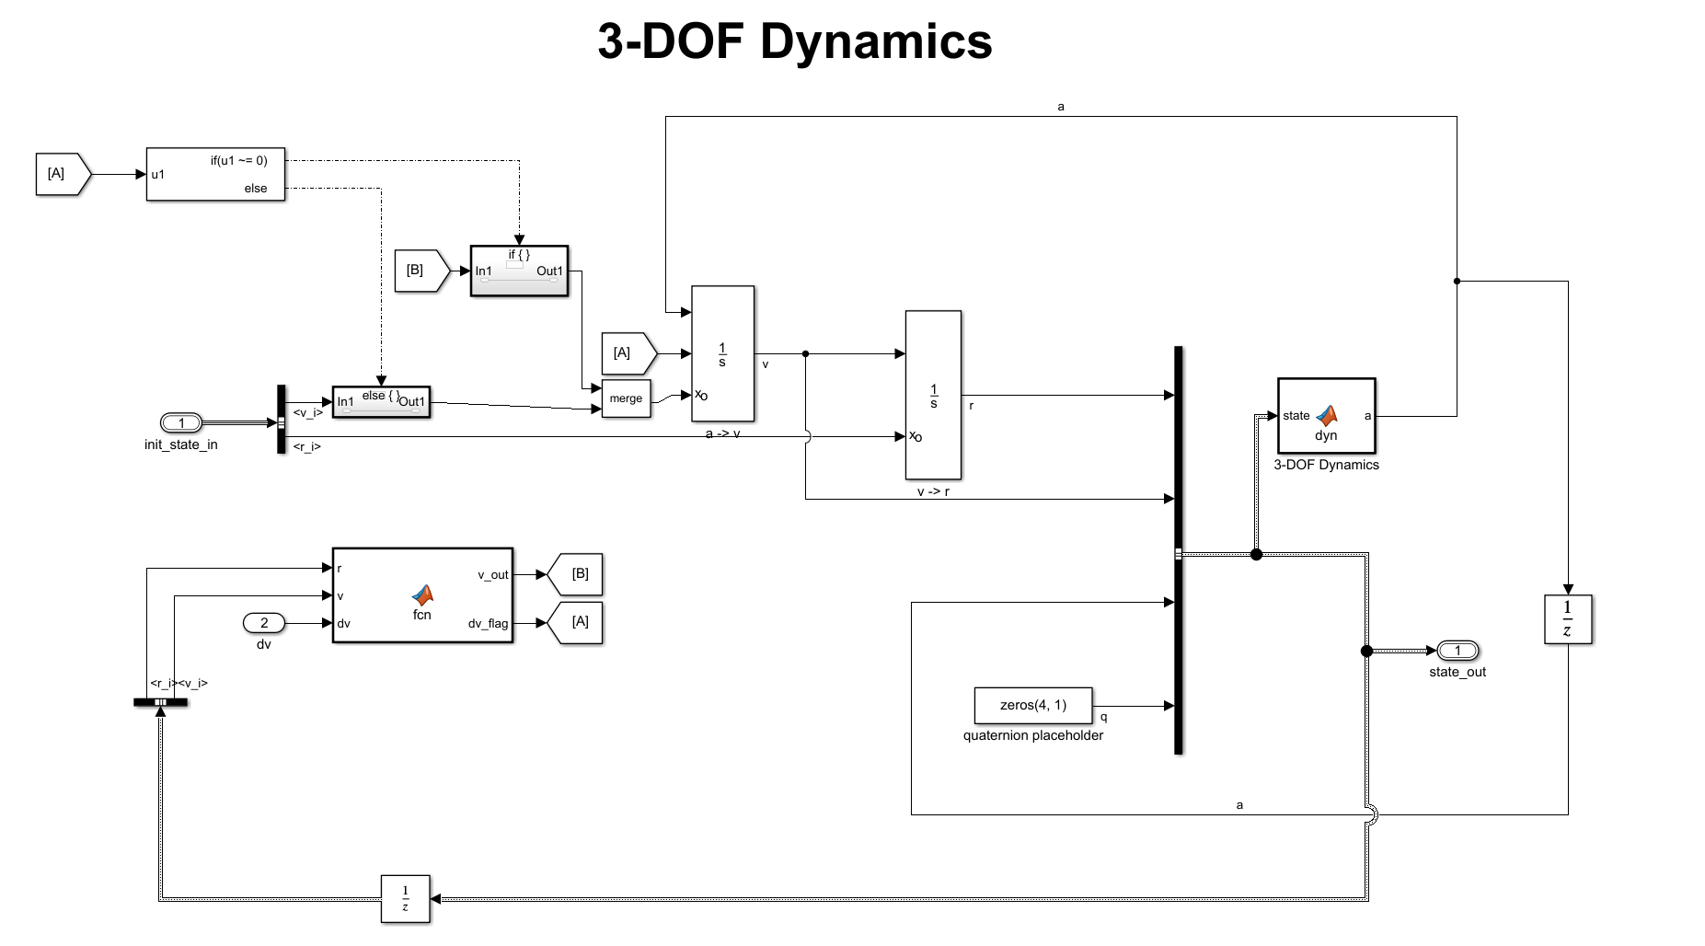
For every impulsive maneuver performed, the integrator has to be reset. Adds additional logic to the sim and is more difficult to handle

Slide 8
HCW – First implementation
Implemented the basic HCW equations
First did so with an IC in the rectilinear frame
As the deputy moves around the orbit, the relative position in the RTN frame becomes hard to interpret
Using an IC in the curvilinear frame allows the HCW equations to propagate the curvilinear state giving more reasonable results

Slide 9
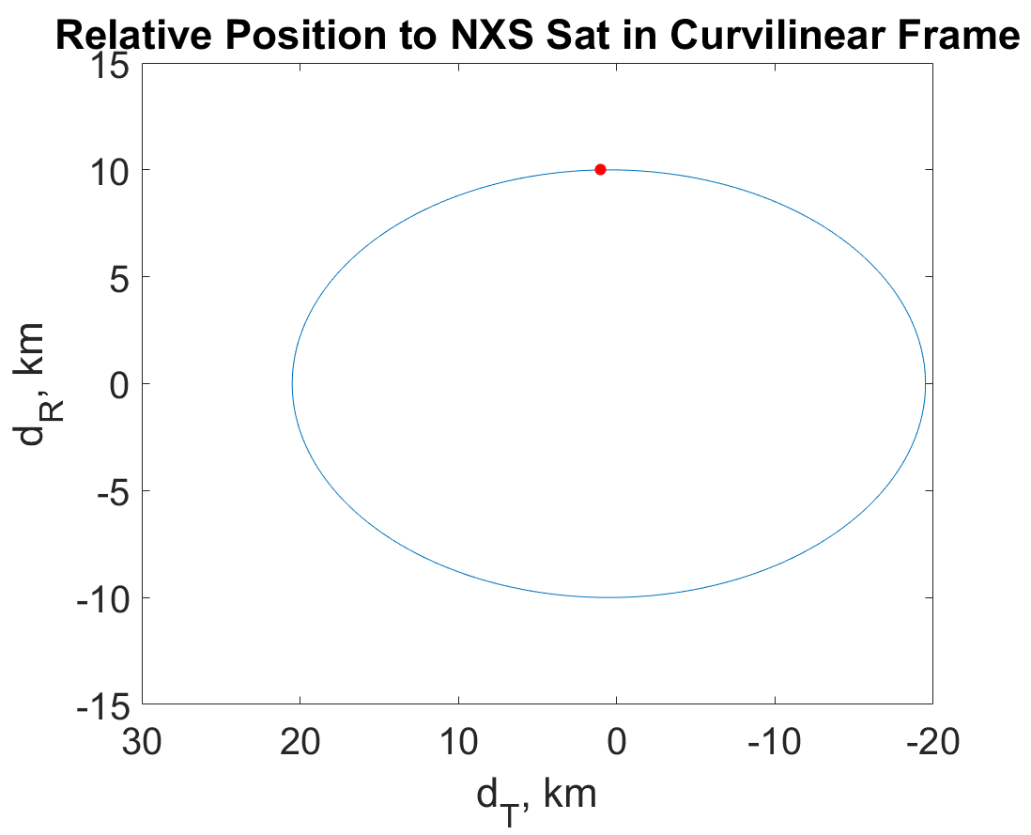
HCW – Bounding Motion
Similar to the inertial simulation where the semi-major axis needs to be set, the velocity in the along-track direction needs to be set to bound the motion

Slide 10
HCW – Rendezvous Mission Framework
Targeting specific positions is fairly easy in the HCW equations when compared to inertial coordinates
Inputs: Desired position in the relative frame, time of transfer orbit (nt)
Then using the linearized equations, the simulation can calculate the dV needed to change the course of the deputy to reach the desired position
The motion of moving between desired positions is helpful for the planning of the rendezvous mission
Much easier to design the mission in this framework than in inertial sim, but no J2 or drag

Slide 11
Next Steps
Next Week:
YA equations → less time on this, mainly just to explore their use
ROE representation → get moding and maneuver framework ready in this
After getting sims set up in both inertial and HCW equations ROE seems the way to go. Includes perturbations and allows for maneuvers.
Further Future:
Control/Moding plans
Planning on having 2 sets of maneuvers
One set of approach maneuvers to get to a near orbit
Set of hops, either up r-bar or v-bar for rendezvous
Navigation

